Slide 1
STUDENT MANAGEMENT SYSTEM
SUBMITTED BY
T JANANI

Slide 2
INTRODUCTION
In this, I have completed the project in Java – Swing with Mysql database.
Development tools and technologies are
JDK Eclipse – 15.0.2
MYSQL Connector – mysql-connector-java-8.0.27

Slide 3
In this, I have used login id and password to search a particular record.
I have created the student profile, all semesters results and placement details.
I used add, delete, update operations for the records.

Slide 4
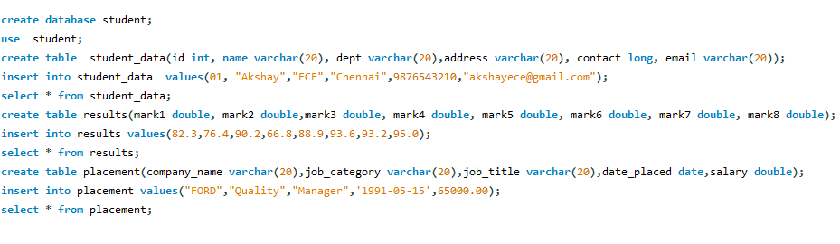
DATABASE SETUP
Here, First created a database and tables of the project. Then inserted the values in to the tables.
My Database name – Student
Table names – Student data, Results, Placement.

Slide 5
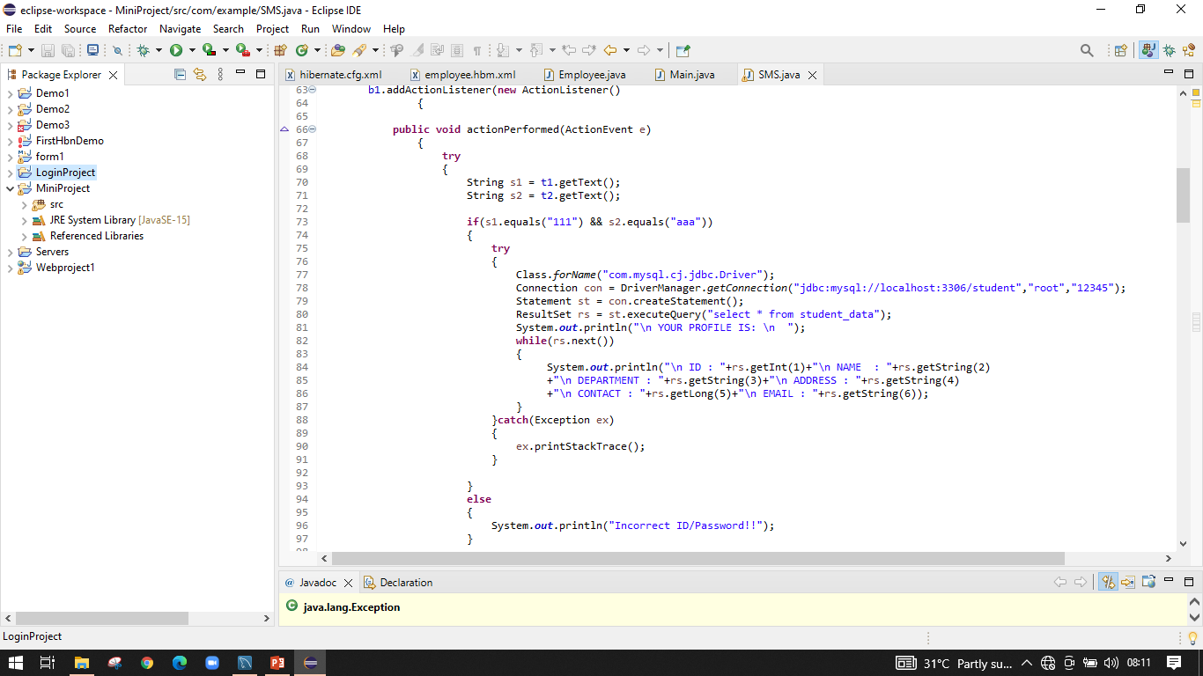
In Java Eclipse,
This is the code for the login id and password with a student profile.

Slide 6
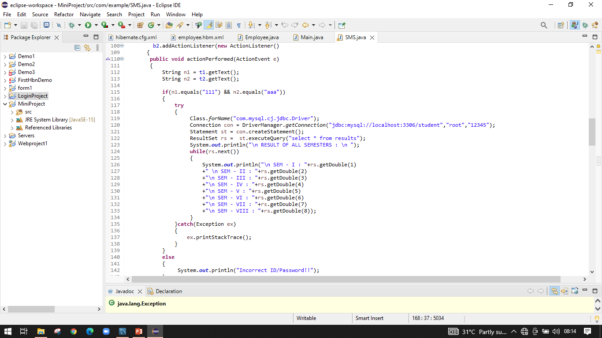
This is the code for the login id and password with a student results.

Slide 7
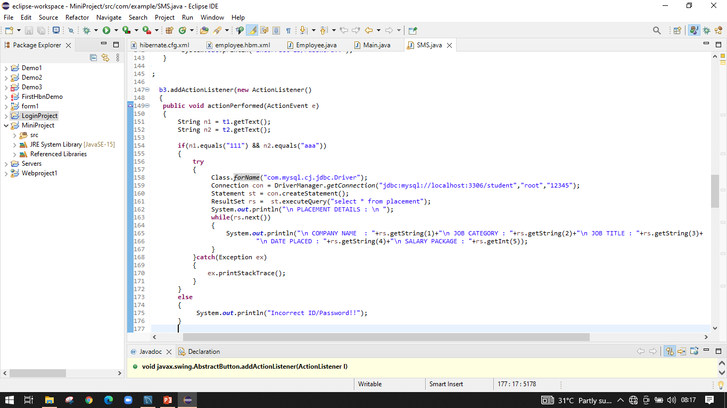
This is the code for the login id and password with a student placement details.

Slide 8
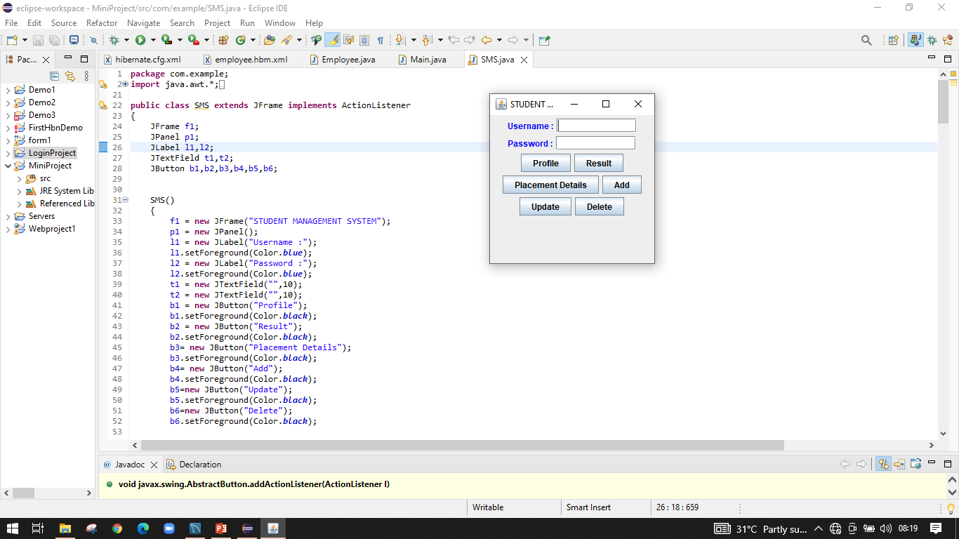
Basic output of the project

Slide 9
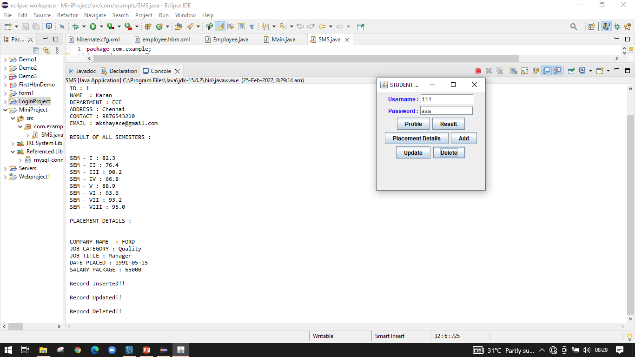
This is the full output - results, placement details with add, delete and update the records.

Slide 10
THANK YOU

